Slide 1
HIRE YOUTUBE INFLUENCER
Rajeshwari Siddipeta : 700734100
Chandrika Yenugula : 700734544
Yaswanth Machavarapu : 700733080
Niveditha Panguluri : 700734527

Slide 2
PROJECT DESCRIPTION
Youtube Influencer/ YOUTEK is a web or mobile based application that acts as platform for clients/companies to hire youtubers for their products brand promotion. The main purpose or objective of this system is to find out top YouTube influencer’s details and their channel as well as number subscribers.
Features:
Sign-up
Login (admin & User)
Search for category
Displays list of youTubers
Select YouTuber
View YouTuber details
Contact YouTuber
Logout

Slide 3









YouTube Influencer – Architecture Diagram
AWS S3
Invoke API call
S3
RDS
Endpoint
API GW
Lambda
AWS Identity and Access Management (IAM)
CloudWatch

Slide 4
SERVICES USED
AWS API GW – APIs act as the "front door" for applications to access data, business logic, or functionality from your backend services.
AWS Lambda - AWS Lambda is a serverless, event-driven compute service that lets you run code for virtually any type of application or backend service without provisioning or managing servers.
AWS CloudWatch - CloudWatch collects monitoring and operational data in the form of logs, metrics, and events.
AWS IAM - AWS Identity and Access Management (IAM) is a web service for securely controlling access to AWS resources.
AWS RDS - Amazon Relational Database Service (Amazon RDS) is a collection of managed services that makes it simple to set up, operate, and scale databases in the cloud.
AWS S3 - Amazon Simple Storage Service (Amazon S3) is an object storage service that offers industry-leading scalability, data availability, security, and performance.
AWS SES – Admin receives a confirmation mail once when the client requests for the YouTuber

Slide 5
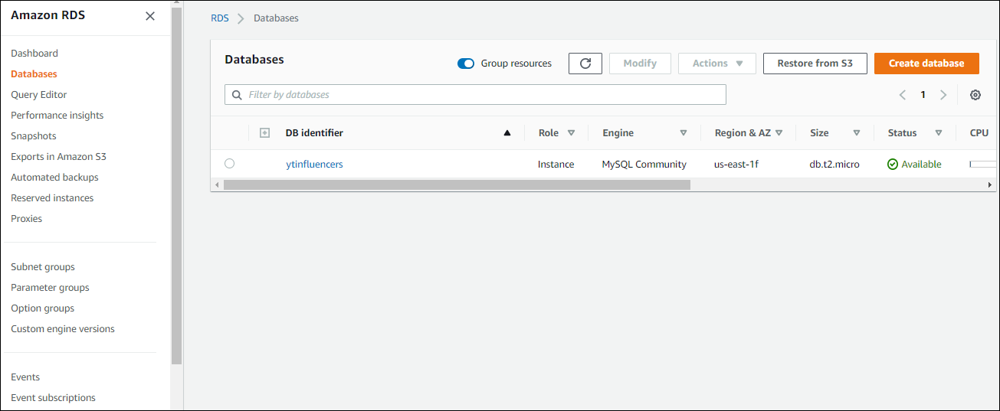
AWS RDS
For this application, we used MySQL Relational Database for storing the user login and Youtubers data.
To create database, click on create database and then select Mysql and
provide username and password.

Slide 6
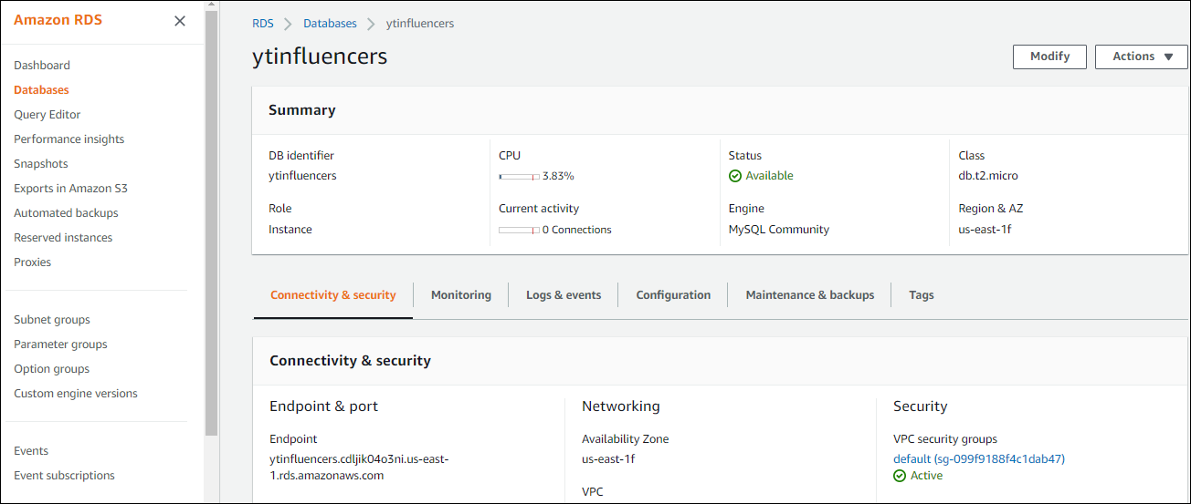
After Creating DB instance, an endpoint and port will be generated.
Endpoint: ytinfluencers.cdljik04o3ni.us-east-1.rds.amazonaws.com Port: 3306
This endpoint will be used in the back-end application as Database properties.

Slide 7
AWS API GW
In AWS API Gateway we have list of API’s configured like GET, POST. In this Application We have end point APIs as follows :
/contact_us : This is a POST API which sends an email to the youtuber when click on contact_us
/influencer : A GET API which retrieves the details of a particular influencer
/influencer_list : A GET API that retrieves a list of influencers
/login : This is a POST API which helps to login the application
/provision : A POST API which helps the admin to post the details of an influencer

Slide 8
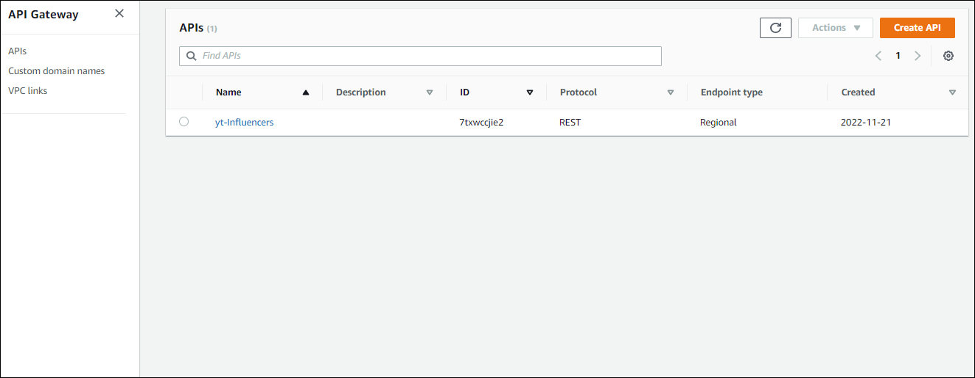
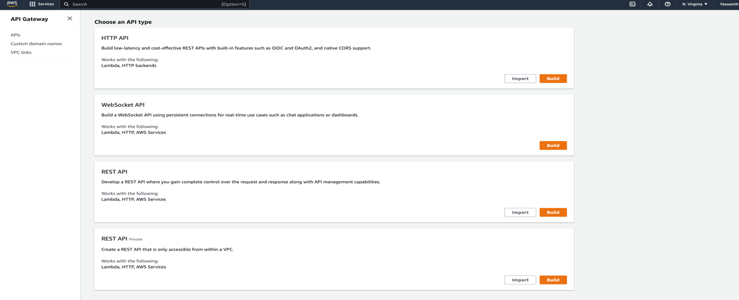
Click on create API
Now select REST API and build

Slide 9
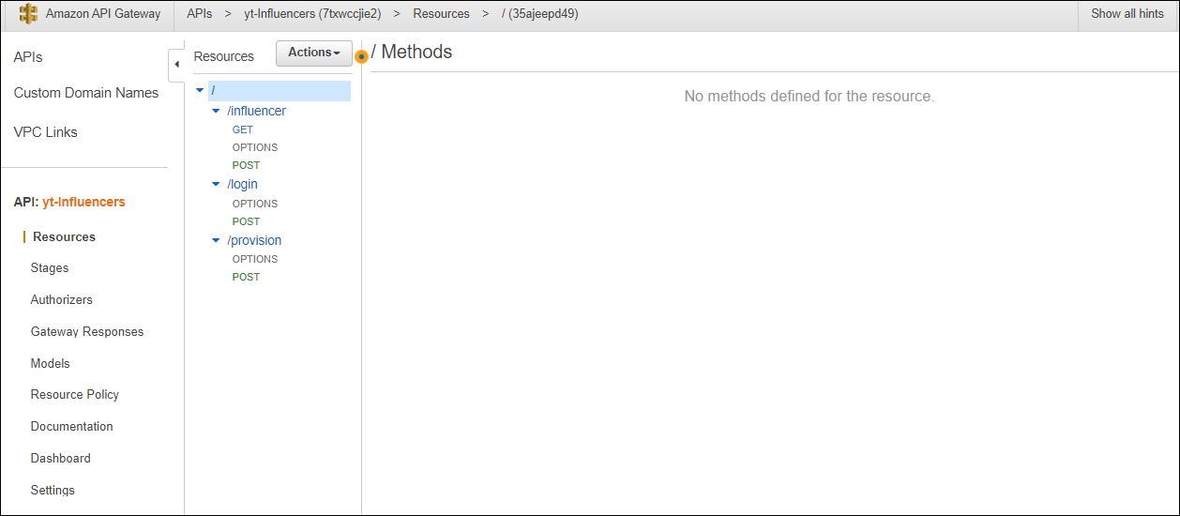
Select the API
Click on actions and create method and resource

Slide 10
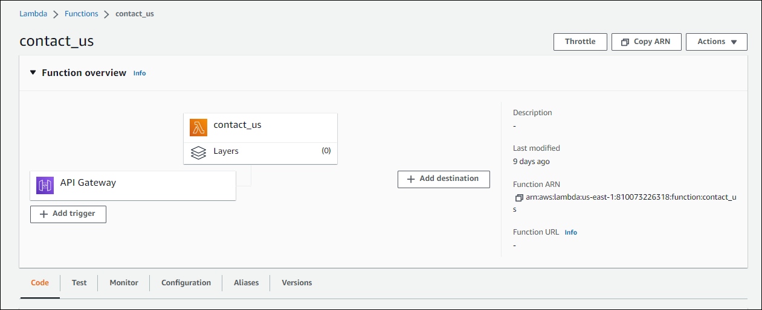
AWS Lambda
we create a function in AWS Lambda

Slide 11
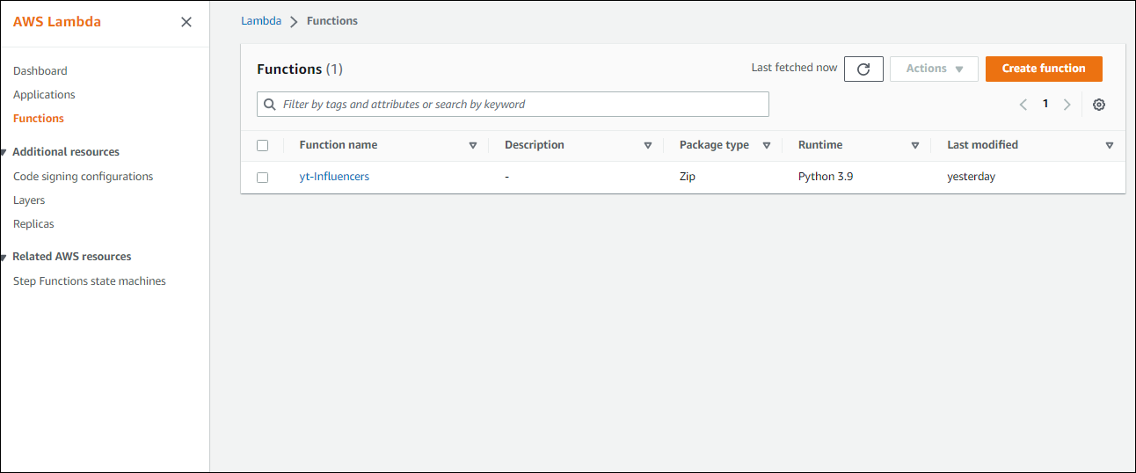
In this step, we add a trigger which is API Gateway

Slide 12
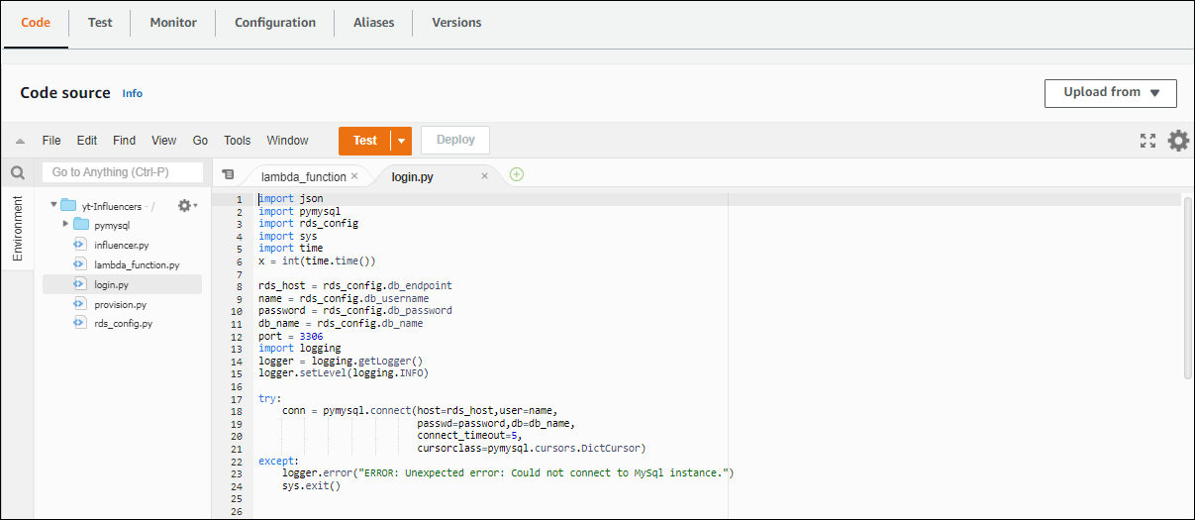
On the console we write the backend code and deploy

Slide 13
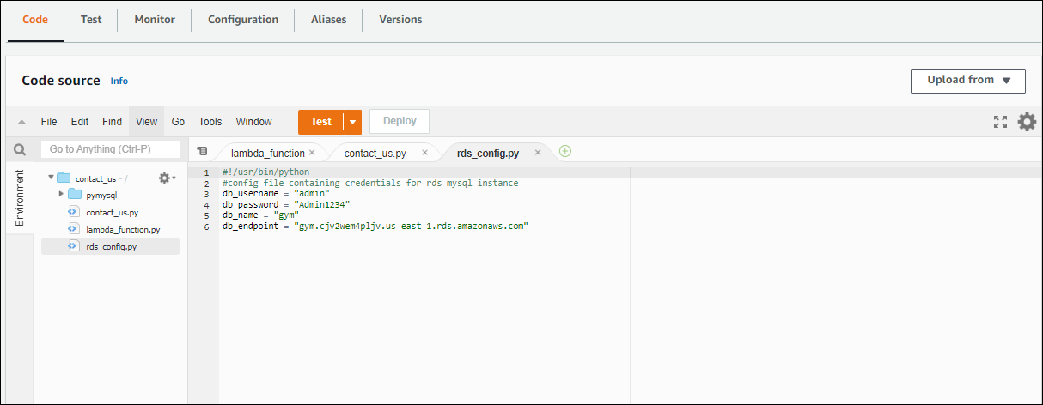
Here we will provide the endpoint and database properties in rds_config.py.

Slide 14
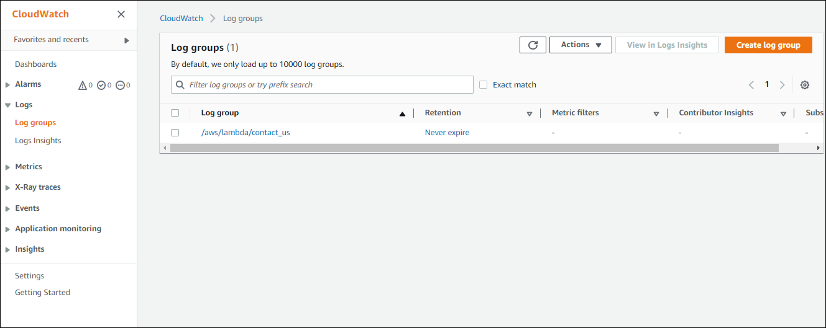
AWS CloudWatch
CloudWatch provides actionable data and insights to help you monitor applications, react to changes in system performance, and optimize resource utilization.
From the lambda console, click on monitor to view logs .

Slide 15
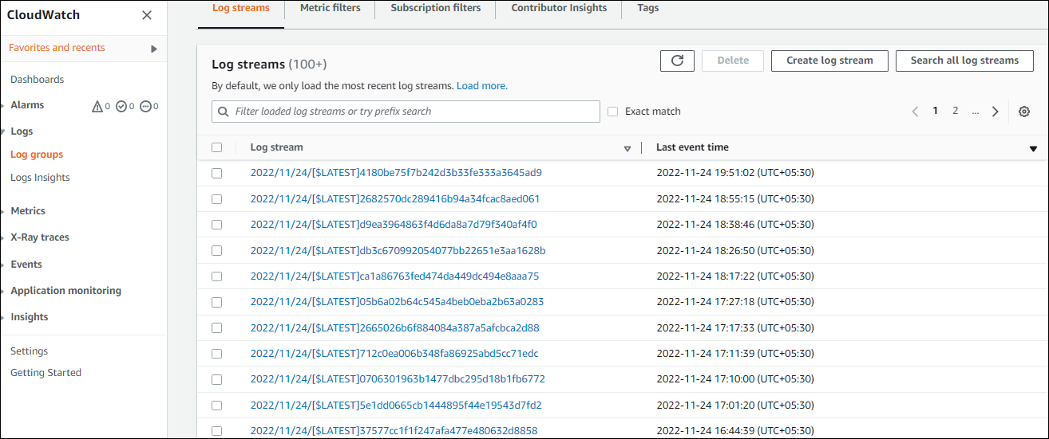
Now, click on individual logs to view the detailed description

Slide 16
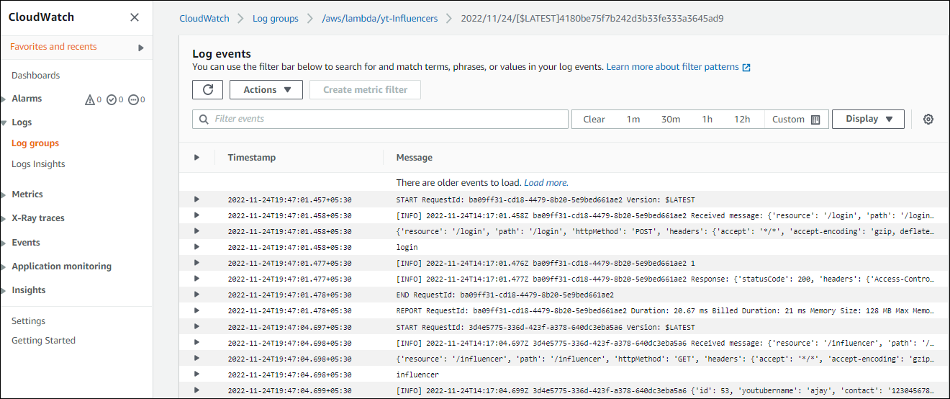
View the detailed description of each log

Slide 17
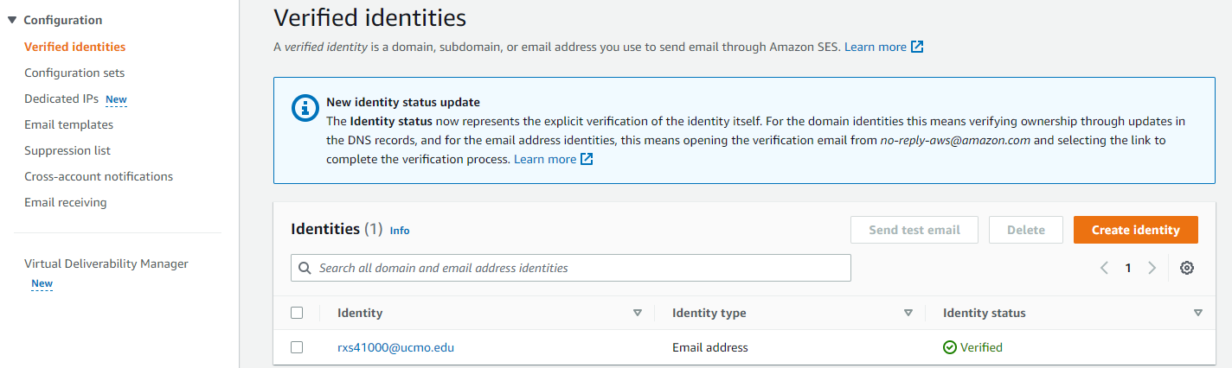
AWS SES (Simple Email Service)
We can integrate applications running on AWS Lambda with AWS SES to send emails. This application contains email service, in order to send a confirmation email to the admin.
Before sending the email, the user email needs to be verified in AWS SES. To do that, we need to create identity and provide that particular user email address. The figure contains the list of user’s email address which has already been verified.

Slide 18
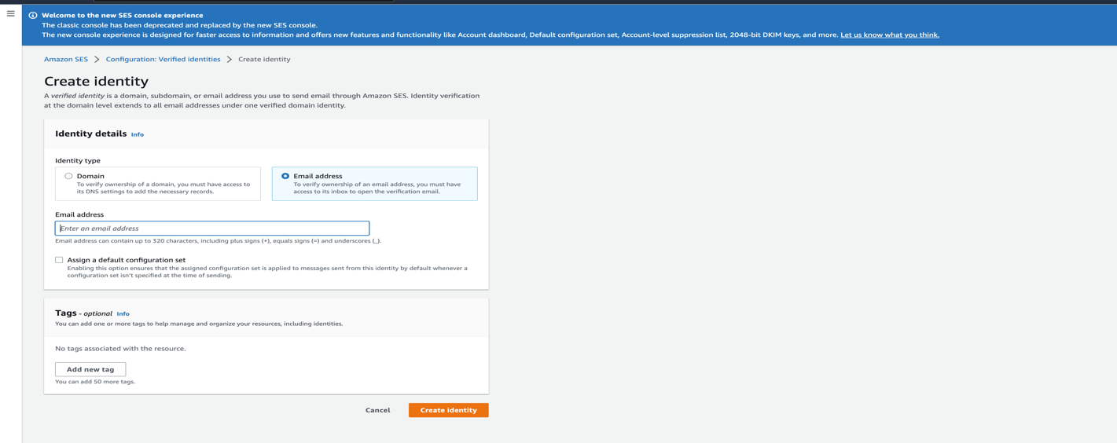
Give the email address to whom the mail should be sent and then click on create identity.

Slide 19
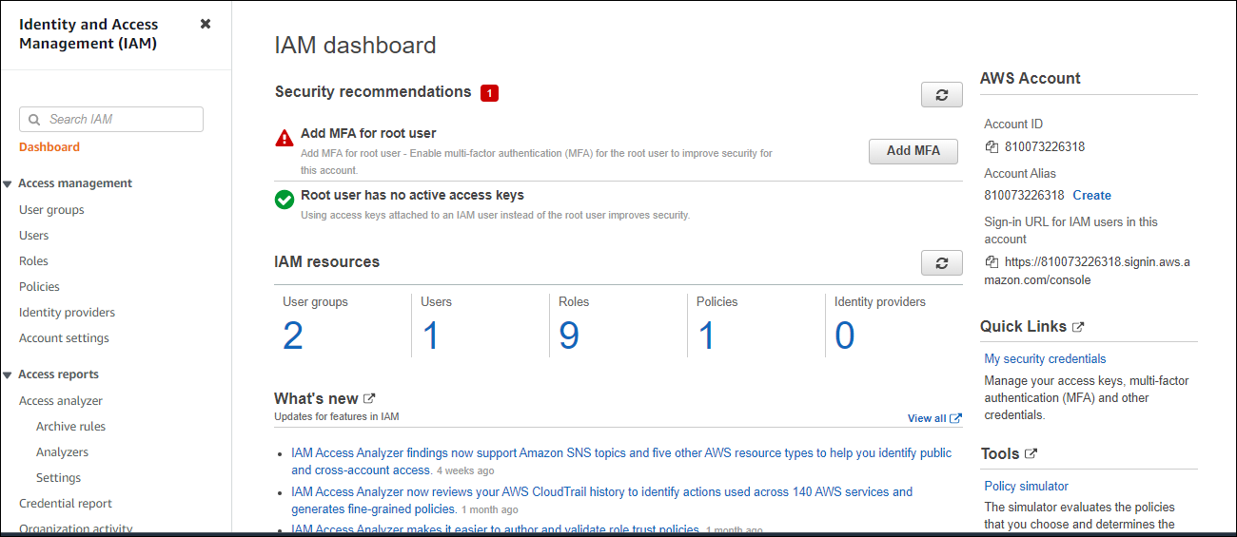
AWS IAM
Click on Roles and then create role for Lambda, API Gateway, RDS and SES services.

Slide 20
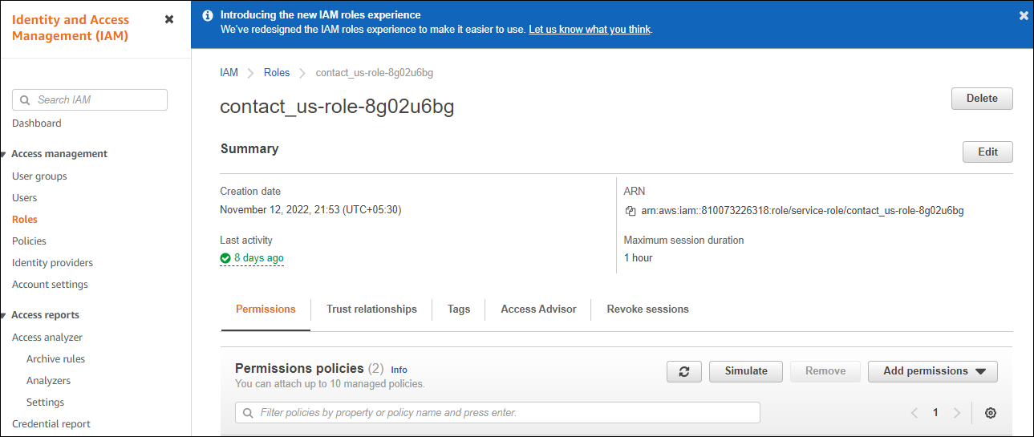
Add policy for Lambda

Slide 21
AWS S3
Amazon Simple Storage Service (Amazon S3) is an object storage service that offers industry-leading scalability, data availability, security, and performance
Click on create bucket
Upload the files such as html, css, js and Images here.
On permissions tab, add policy
In properties tab, click on edit static website hosting
Enable static website hosting here and end point will be created and that will be our application url.

Slide 22
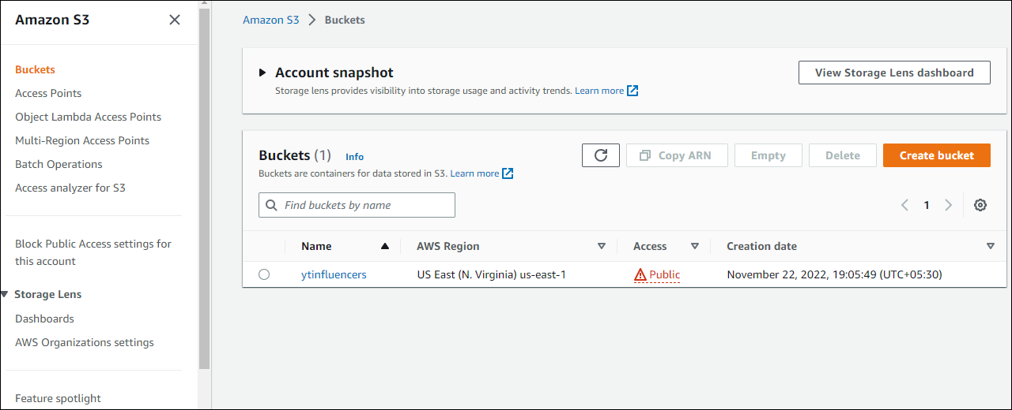
Create S3 Bucket

Slide 23
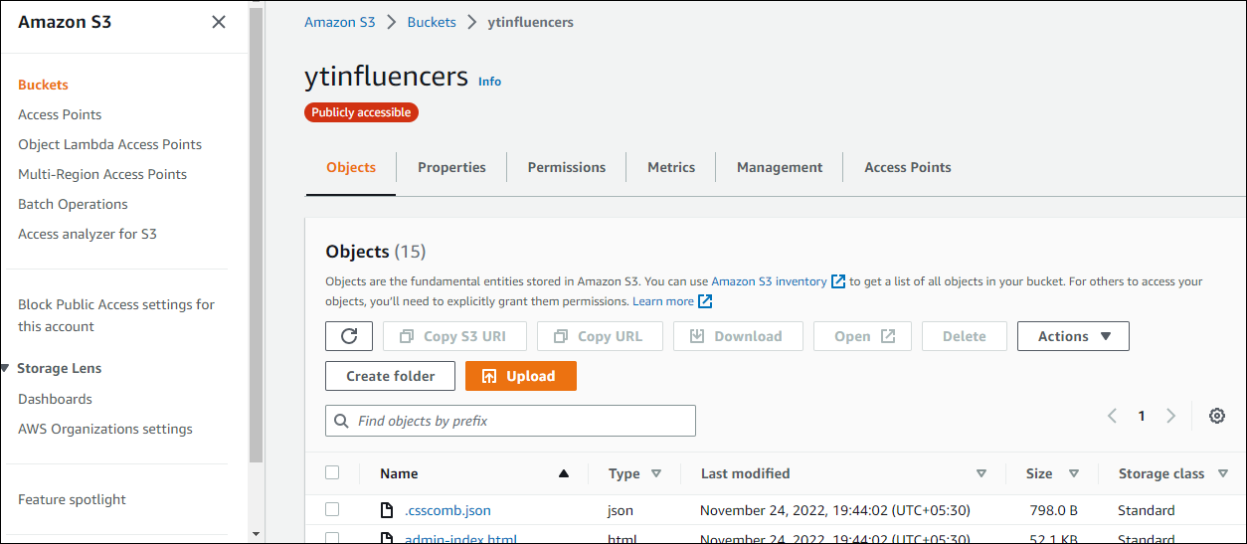
Upload the files such as html, css, js and Images here.

Slide 24
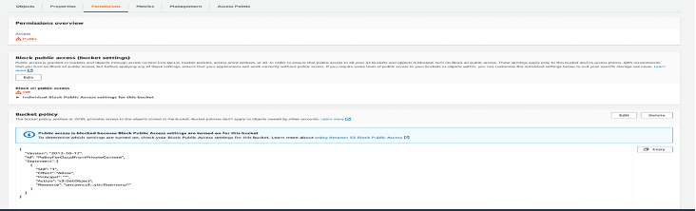
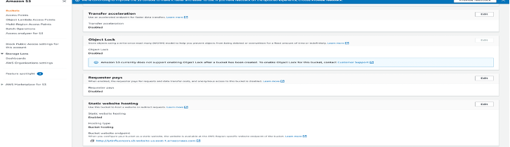
Add Policy by clicking on permissions tab
click on edit static website hosting, in properties tab

Slide 25
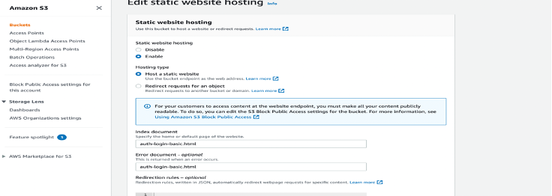
Enable static website hosting here and end point will be created and that will be our application url.

Slide 26
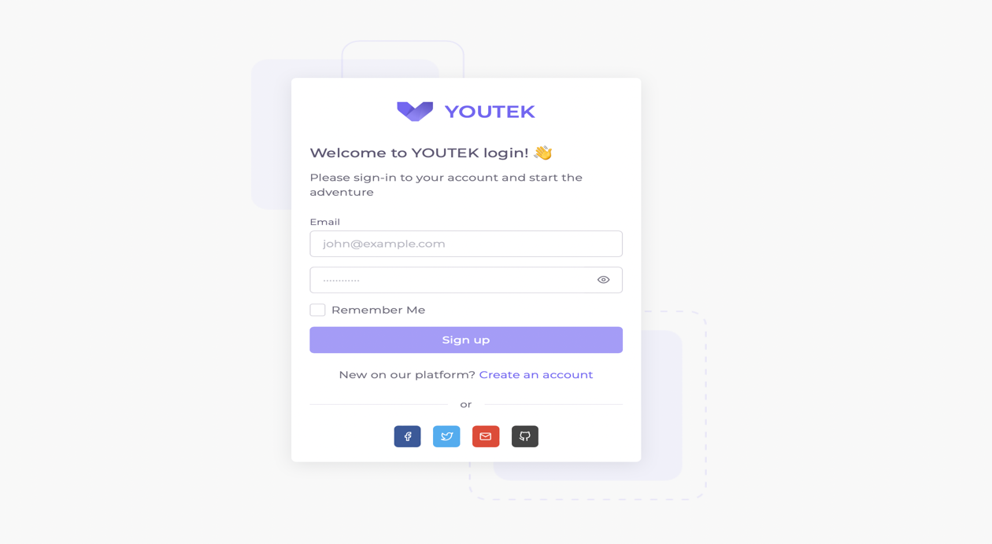

Slide 27
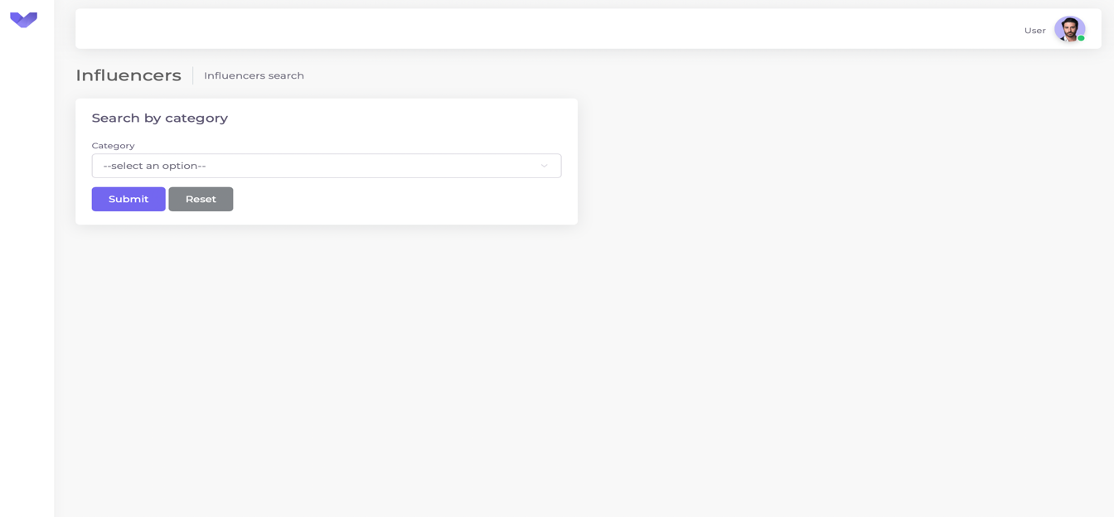
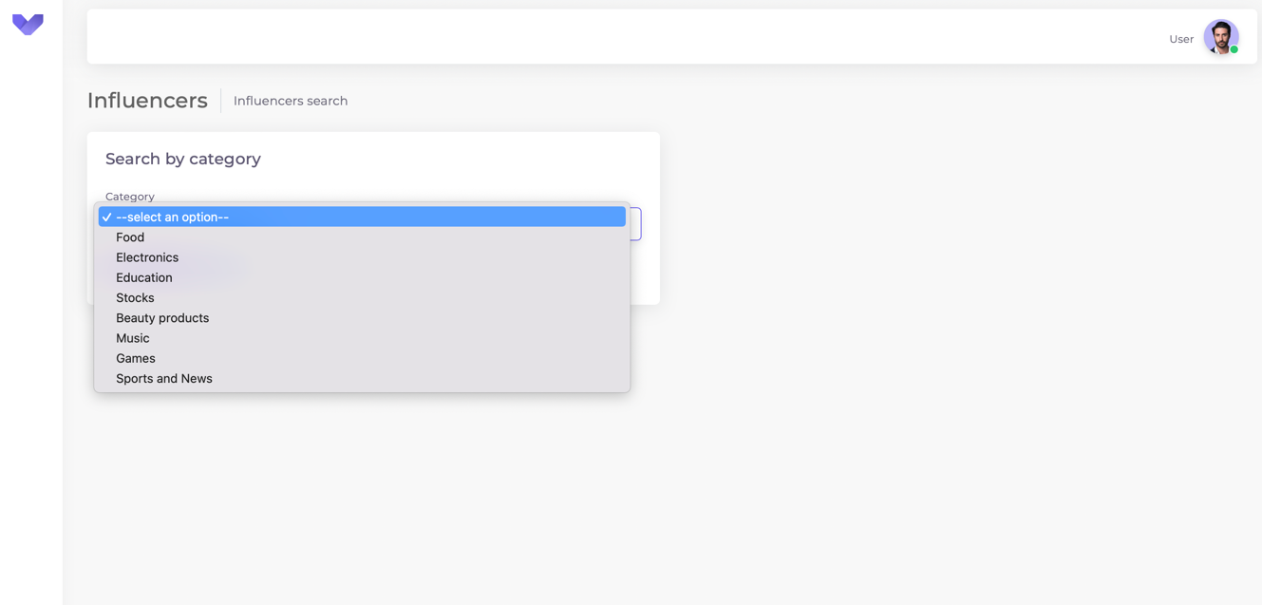
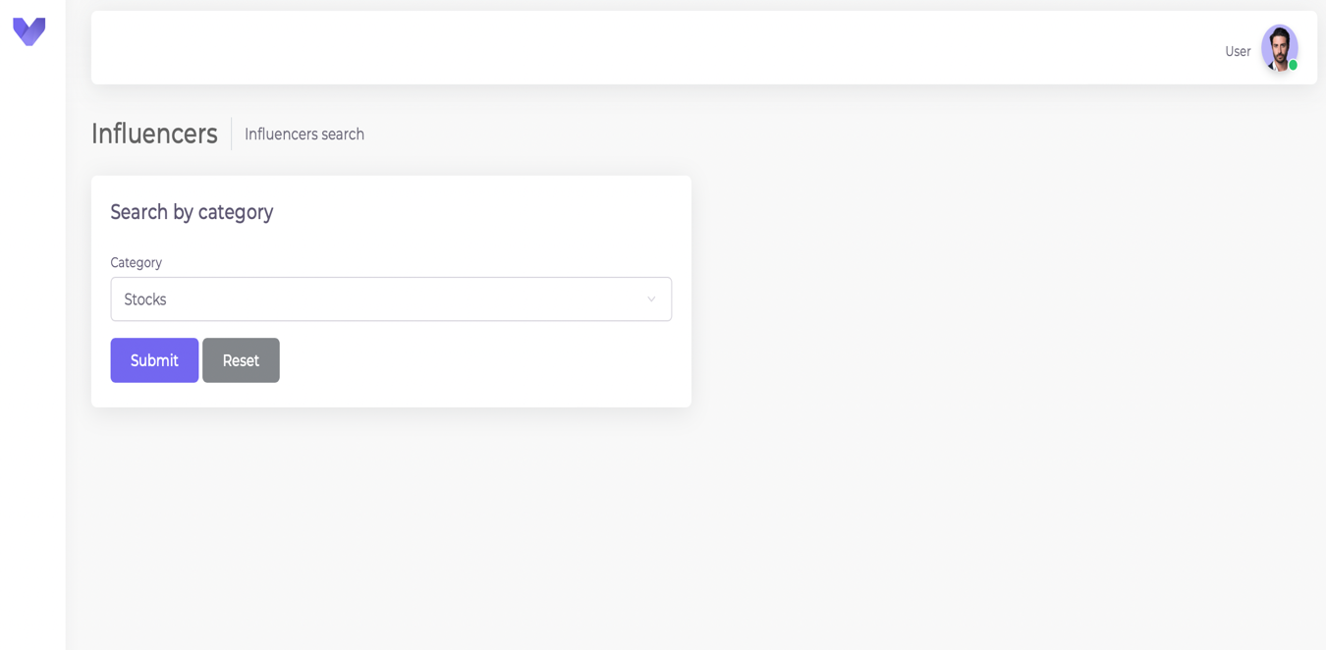

Slide 28
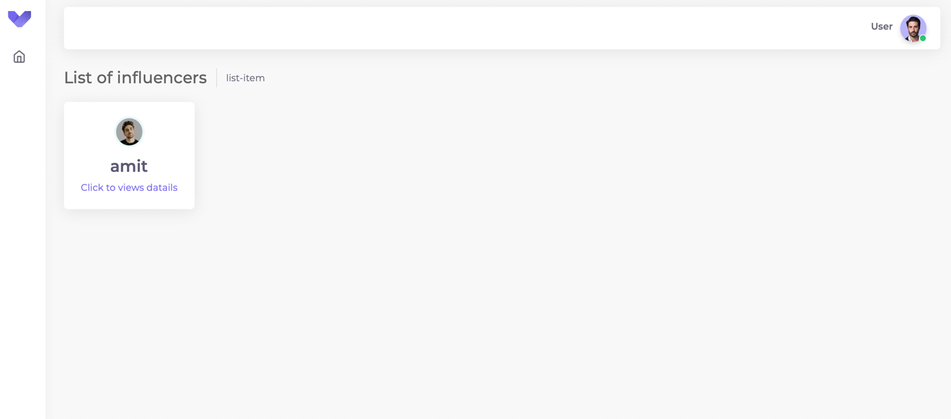
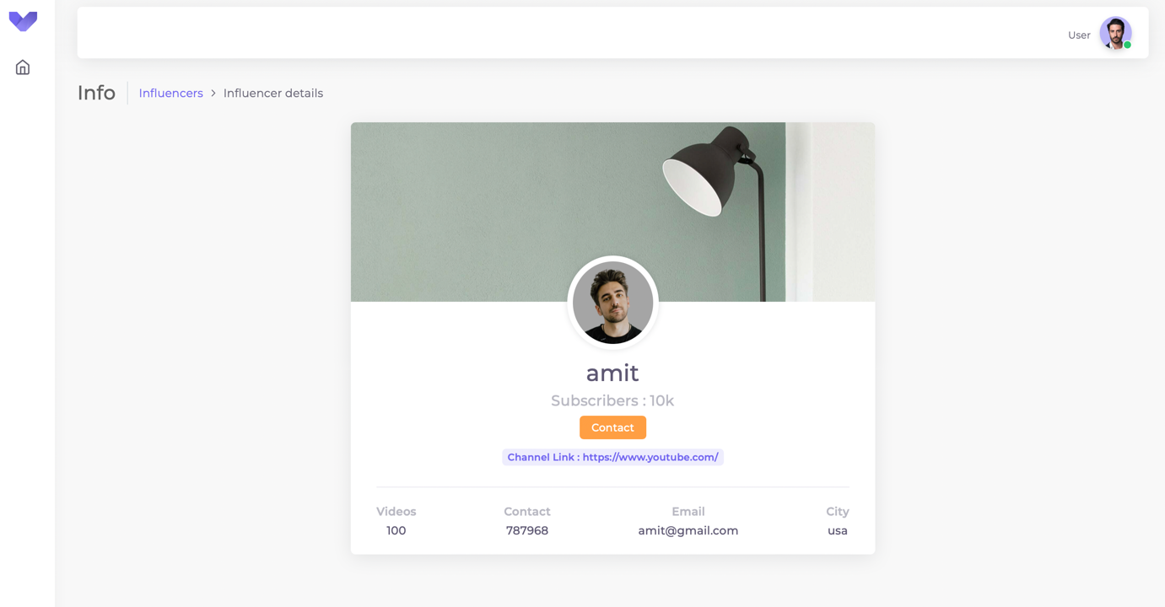

Slide 29
Thank you!

